Slide 1

Earthquake Data Visualization
By Anshu Anamika

Slide 2
Data information
time: The exact time the earthquake occurred.
Latitude & longitude : of the earthquake’s epicenter.
depth: How deep the earthquake occurred (in kilometers)
mag: The magnitude (strength) of the earthquake. Can be negative for microquakes.
magType: The method used to calculate magnitude, e.g.:
ml: Local magnitude (Richter)
md: Duration magnitude
mb: Body-wave magnitude
ms: Surface-wave magnitude
mw: Moment magnitude
nst: Number of seismic stations used to determine the location.
gap: Largest azimuthal gap (degrees) in station coverage (smaller is better).
dmin: Horizontal distance from the epicenter to the nearest station (in degrees).
rms: Root mean square of travel-time residuals (smaller is better fit).
magNst: Number of stations contributing to the magnitude estimate.
net: Network code of the reporting seismic network (e.g., nc = Northern California)

Slide 3
locationSource: Network that determined the event location. magSource: Network that determined the magnitude.
Code | Likely Region / Organization
ak | Alaska Earthquake Center
av | Alaska Volcano Observatory
ci | Caltech/USGS Southern California Seismic Network (SCSN)
hv | USGS Hawaiian Volcano Observatory
mb | Montana Bureau of Mines and Geology
nc | Northern California Seismic System (NCSS)
nm | New Madrid Seismic Zone
nn | Nevada Seismological Laboratory
ok | Oklahoma Geological Survey
pr | Puerto Rico Seismic Network
se | Southeast U.S. Region (possibly Southeastern Consortium)
tx | Texas Seismological Network
us | USGS National Network
uu | University of Utah Seismograph Stations
uw | University of Washington / Pacific Northwest Seismic Net

Slide 4
1.How’s the earthquake distribution across different latitude and longitude?

Slide 5
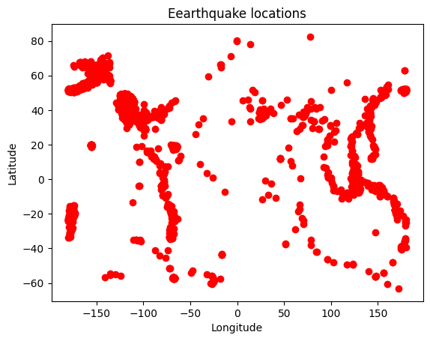

Slide 6
2.How’s earthquake magnitude distribution ?

Slide 7
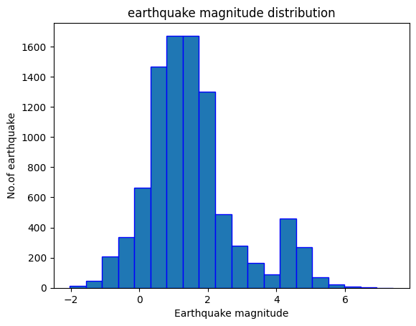

Slide 8
3.What are the top10 places faced highest earthquake magnitude?

Slide 9
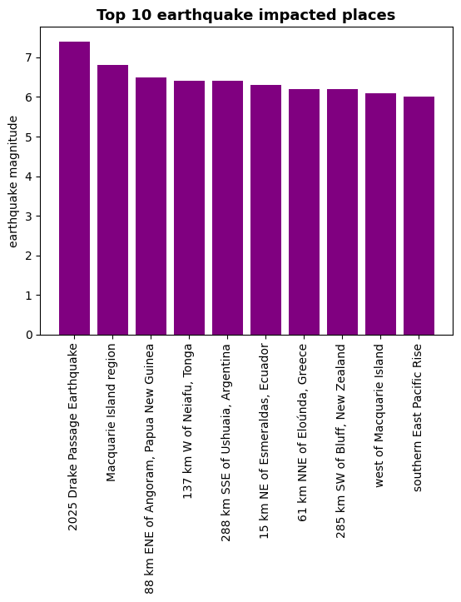

Slide 10
4.How many earthquakes reported by different networks?

Slide 11
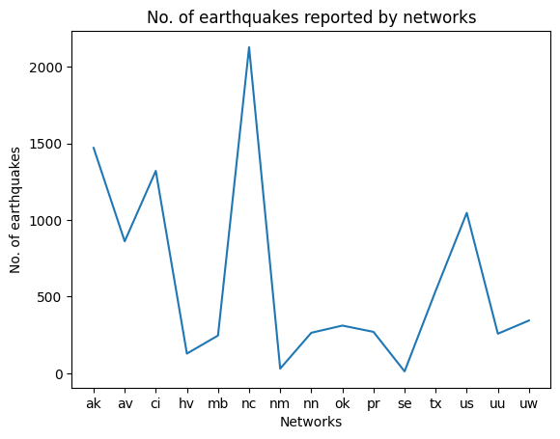

Slide 12
4.What are the most common methods used for calculating magnitude?

Slide 13
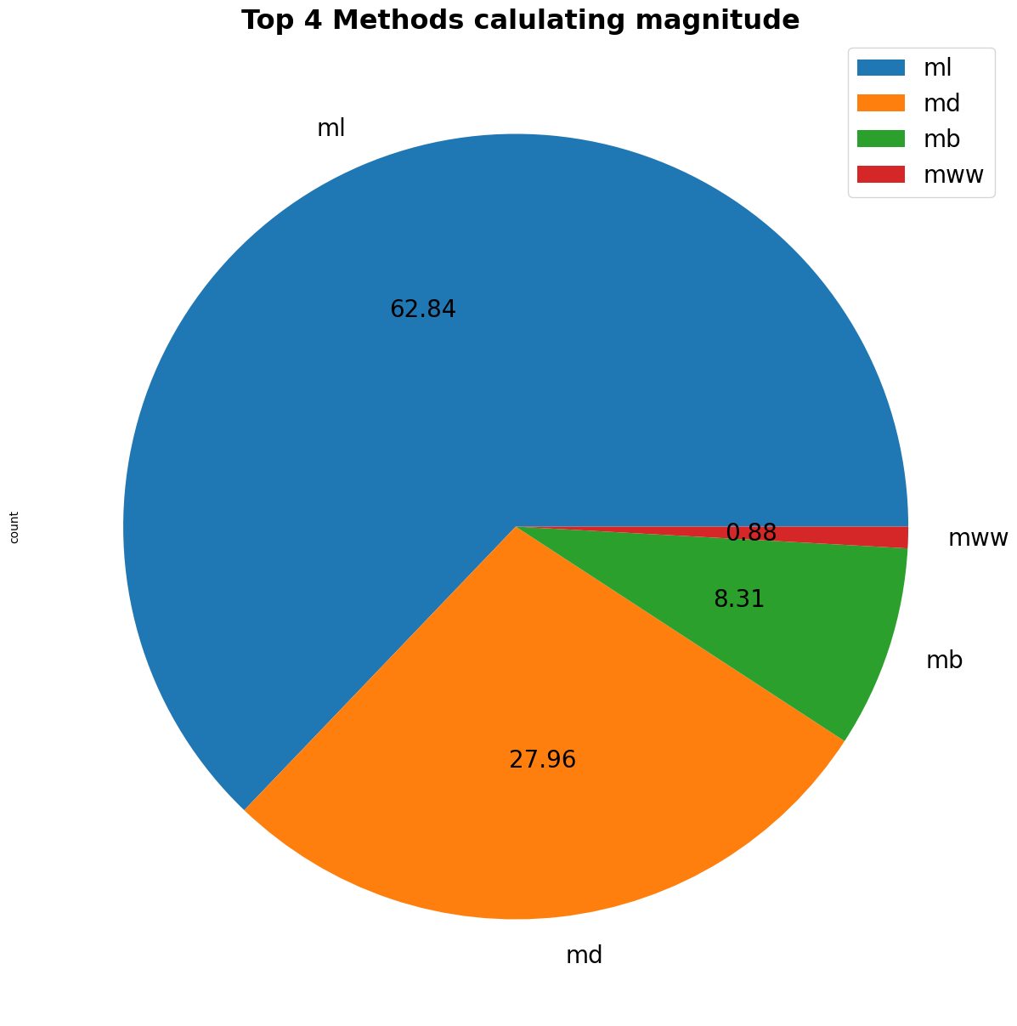

Slide 14
Thank you

